Slide 1




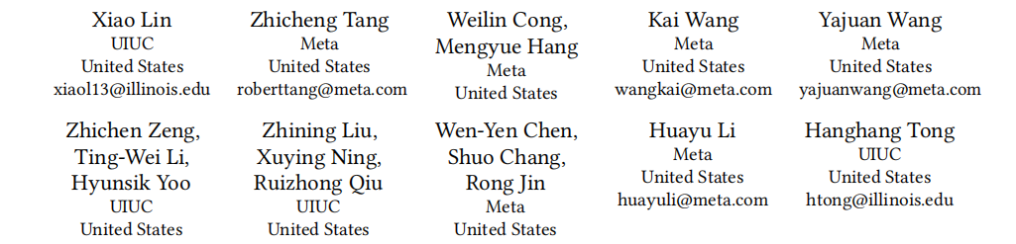



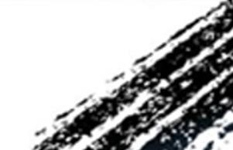

ATAI
Advanced Techniqueof Artificial Intelligence
ATAI
ChongqingUniversity _{AdvancedTechniqueof}
of Technology Artificial Intelligence
Chongqing University of
Technology
Chongqing University ^{ATAI}
_{of Technology} Advanced Techniqueof
Artificial Intelligence
Chongqing University of Technology
Chongqing University of Technology
Mixture of Sequence:Theme-Aware Mixture-of-Experts for
Long-Sequence Recommendation
Code — https://github.com/xiaolin-cs/MoS.
WWW—2026
Reported by ZhiWei Xu
1

Slide 2

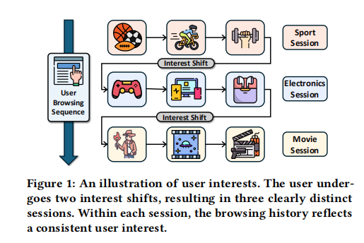
ATAI
AdvancedTechniqueof
Artificial Intelligence
ATAI
ChongqingUniversity _{AdvancedTechniqueof}
of Technology Artificial Intelligence
ChongqingUniversity of Technology
Motivation
1) However,if the model indiscriminately incorporates
the entire sequence,misleading interactions can dominate the rep resentation and ultimately lead to erroneous predictions .
This issue motivates us to raise a critical question for long-sequence modeling.
2) Existing methods often rely on attention ,selective copying or similar mechanisms to capture long-range dependencies,but these mechanisms are designed as
continuous function approximators for smooth dynamics.

Slide 3

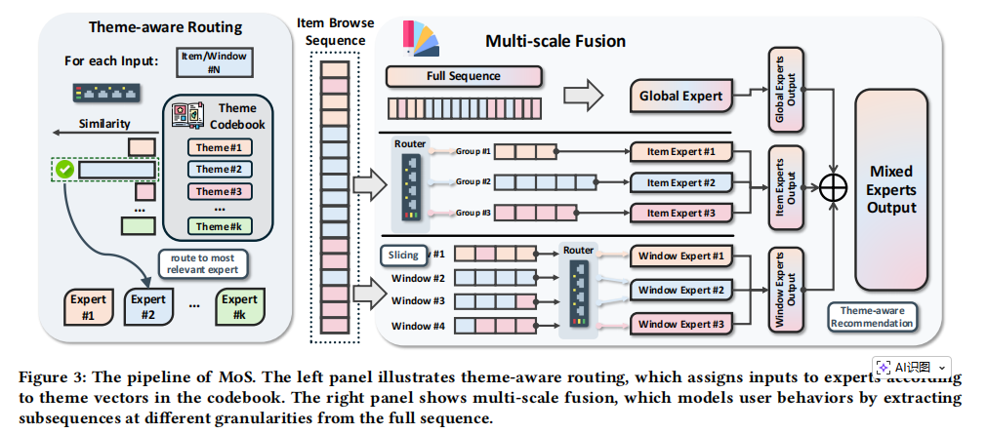
ChongqingUniversity of Technology
ATAI
AdvancedTechniqueof
Artificial Intelligence
ATAI
ChongqingUniversity _{AdvancedTechniqueof}
of Technology Artificial Intelligence
Overview

Slide 4


ChongqingUniversity of Technology
ATAI
AdvancedTechniqueof
Artificial Intelligence
ATAI
ChongqingUniversity _{AdvancedTechniqueof}
of Technology Artificial Intelligence
Method

Slide 5


ChongqingUniversity of Technology
ATAI
AdvancedTechniqueof
Artificial Intelligence
ATAI
ChongqingUniversity _{AdvancedTechniqueof}
of Technology Artificial Intelligence
Method

Slide 6

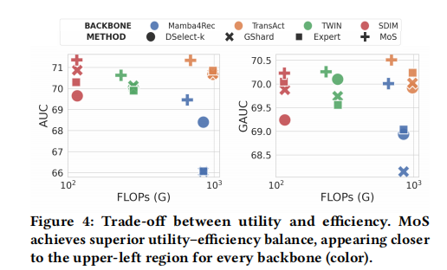
ATAI
AdvancedTechniqueof
Artificial Intelligence
ATAI
ChongqingUniversity _{AdvancedTechniqueof}
of Technology Artificial Intelligence
ChongqingUniversity of Technology
Experiments

Slide 7
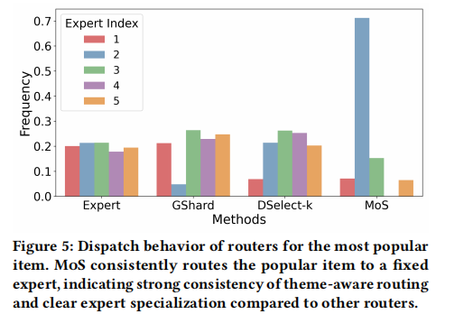
ATAI
AdvancedTechniqueof
Artificial Intelligence
ATAI
ChongqingUniversity _{AdvancedTechniqueof}
of Technology Artificial Intelligence
ChongqingUniversity of Technology
Experiments

Slide 8
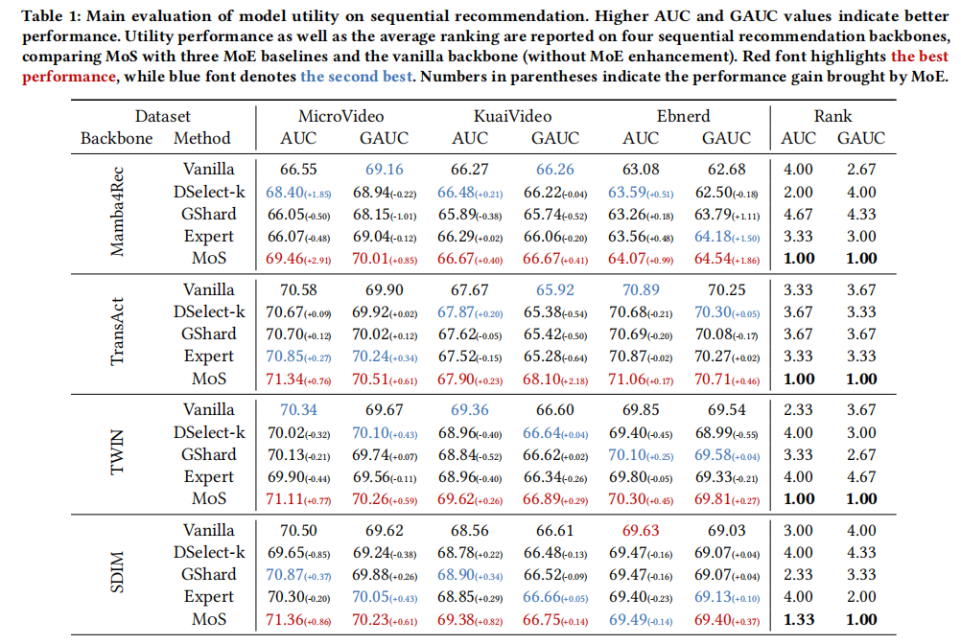
ATAI
AdvancedTechniqueof
Artificial Intelligence
ATAI
ChongqingUniversity _{AdvancedTechniqueof}
of Technology Artificial Intelligence
ChongqingUniversity of Technology
Experiments

Slide 9
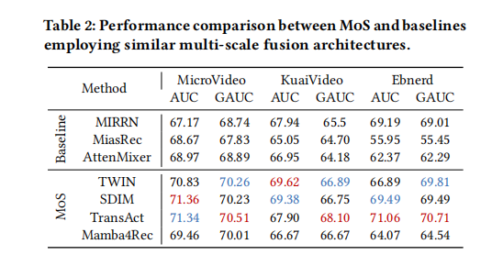
ATAI
AdvancedTechniqueof
Artificial Intelligence
ATAI
ChongqingUniversity _{AdvancedTechniqueof}
of Technology Artificial Intelligence
ChongqingUniversity of Technology
Experiments

Slide 10
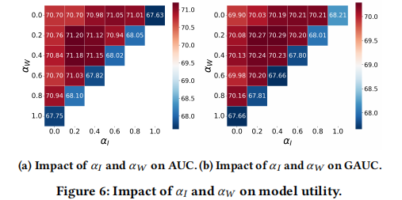
ATAI
AdvancedTechniqueof
Artificial Intelligence
ATAI
ChongqingUniversity _{AdvancedTechniqueof}
of Technology Artificial Intelligence
ChongqingUniversity of Technology
Experiments

Slide 11
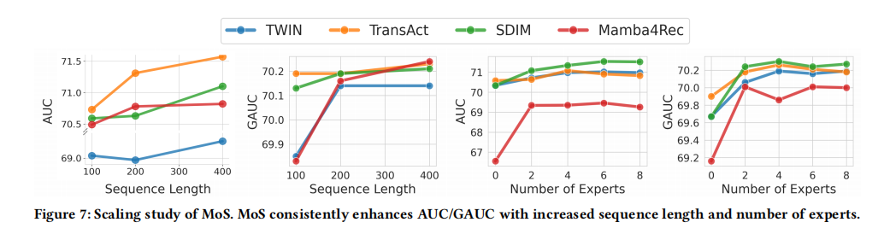
ATAI
AdvancedTechniqueof
Artificial Intelligence
ATAI
ChongqingUniversity _{AdvancedTechniqueof}
of Technology Artificial Intelligence
ChongqingUniversity of Technology
Experiments

Slide 12


ChongqingUniversity of Technology
ATAI
AdvancedTechniqueof
Artificial Intelligence
ATAI
ChongqingUniversity _{AdvancedTechniqueof}
of Technology Artificial Intelligence
Thanks!

